Slide 2
Learning Intention
To learn about the different levels of government used to make decisions and laws in Australia.

Slide 3
Introduction
Think/Pair/Share: What do you already know about how decisions, rules and laws are made in this country?

Slide 4
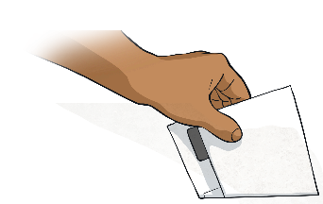
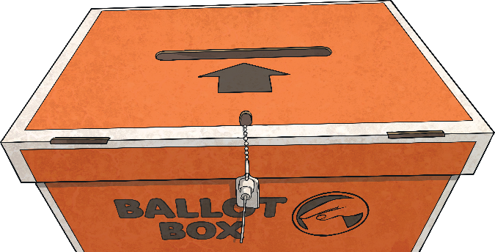
Democracy and Voting
Australia is a democratic country.
This means that people choose or vote for people in elections. These people, called politicians, represent the most popular opinion of the people.
In Australia, everyone who is 18 years or older is required by law to vote for people to govern them.

Slide 5
Levels of Government
Australia has three levels of government that share the power to make different decisions for the country based on their location. These are:
Federal Parliament
State Parliaments
Local Governments

Slide 6
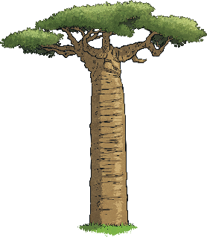

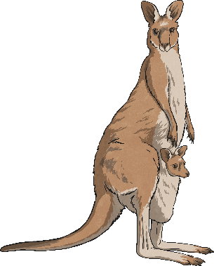

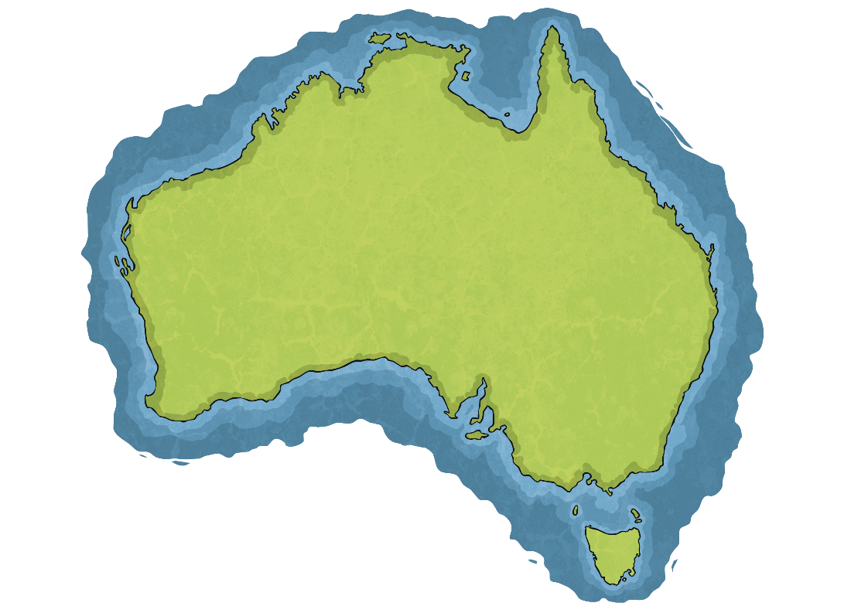
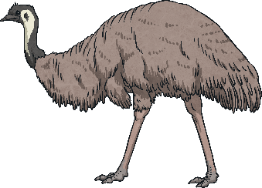

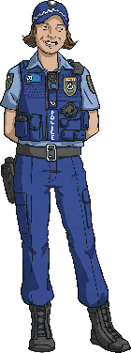
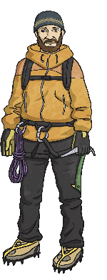

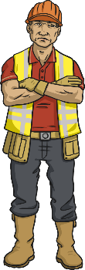

Federal Parliament
Federal Parliament makes choices about Australia as a whole country, such as:
Relationships with other countries
Currency and taxes
Who can visit or live in Australia
Defense, quarantine and trade
The leader of Federal Parliament is called the Prime Minister.

Slide 7
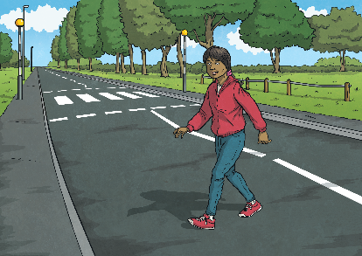
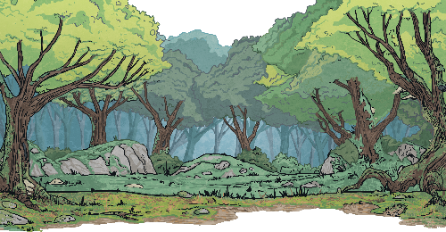
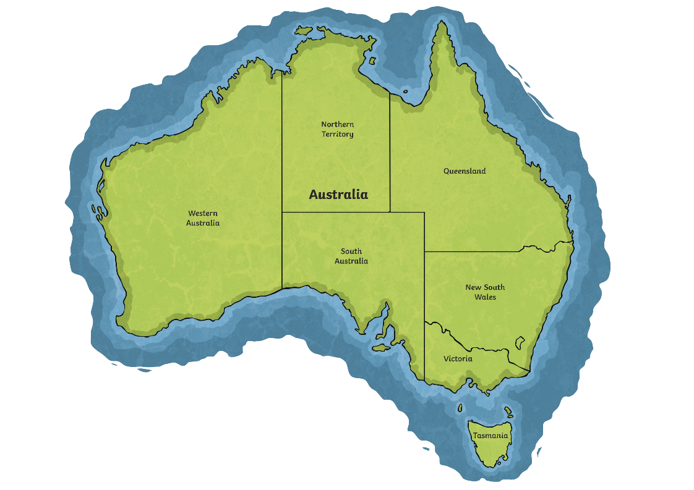
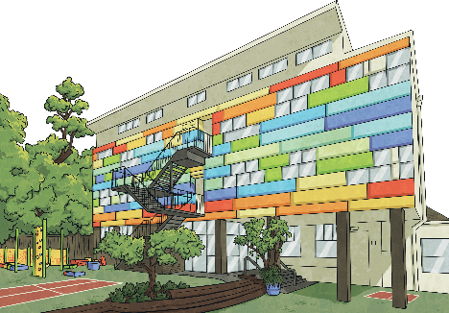
State Parliament
There are eight State Parliaments that make decisions about the state or territory they represent, including:
Schools and hospitals
Water and forests
Transport and roads
Law and order
The leader of State Parliament is called the Premier.

Slide 8
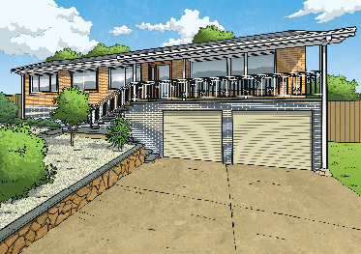
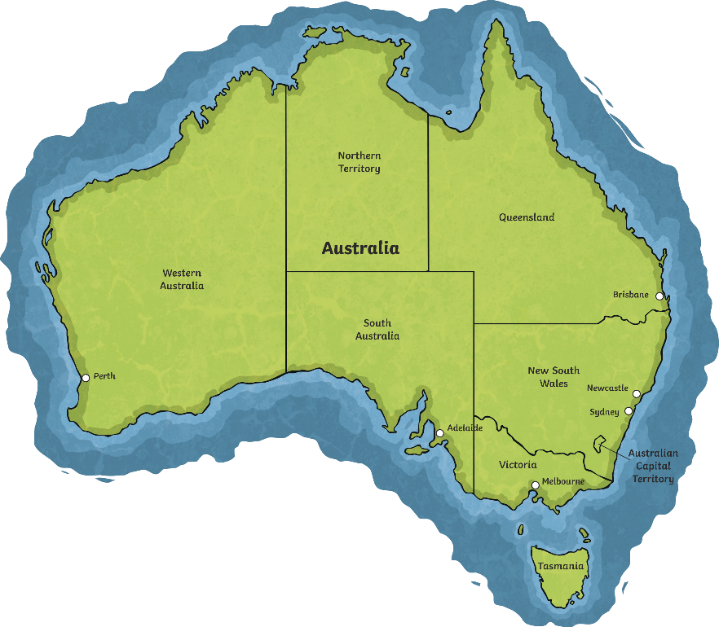
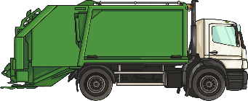
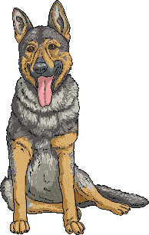



Local Governments
There are hundreds of local governments across Australia. Local governments or ‘councils’ look after issues that affect their smaller areas, including:
What buildings can be built
Parks and gardens
Pets and car parking
Managing waste and recycling
The leader of a local government is called the Mayor.

Slide 9
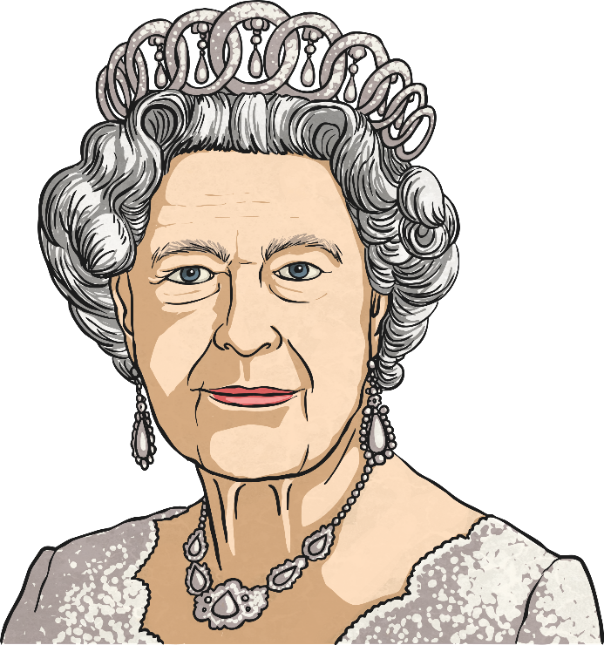
The Queen of Australia?
Australia is also one of sixteen countries that have Queen Elizabeth II as the head of state. This means that we are governed by the Queen of England and she must sign off on all decisions made in all our governments.

Slide 10
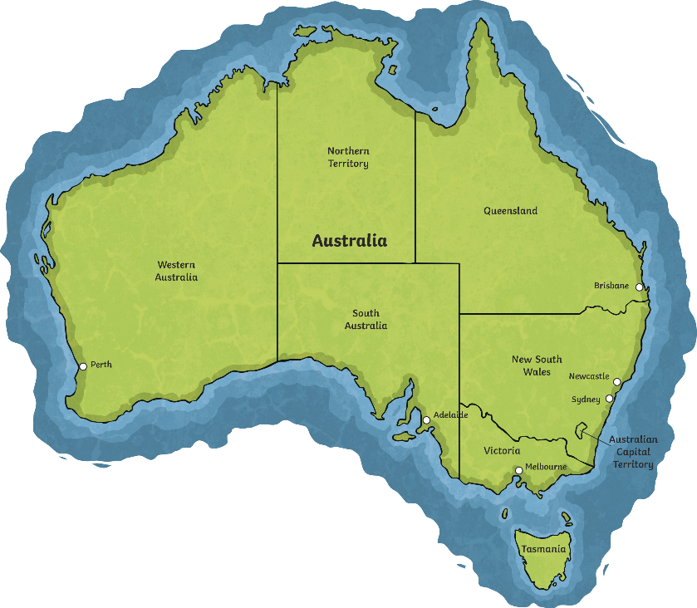
Who Represents the Queen?
As she lives far away and has so many countries to reign over, she has other people, chosen by her, to represent her.
Australia’s Parliament in Canberra has a Governor-General and each state and territory in Australia has a Governor.
Canberra
Governor-General

Slide 11
Governments Quiz
Ready to test your knowledge of Australian governments?
Start Quiz

Slide 12

Governments Quiz
Which government makes decisions about roads?
Federal
State
Local
Reveal Answer
Next Question

Slide 13
Governments Quiz
Which government makes decisions about immigration (people moving to Australia)?
Federal
State
Local
Reveal Answer
Next Question

Slide 14
Governments Quiz
Which government makes decisions about parks?
Federal
State
Local
Reveal Answer
Next Question

Slide 15
Governments Quiz
Can you name the three levels of government?
Federal, state and local
Reveal Answer
Next Question

Slide 16
Governments Quid
What could happen if the Queen disagreed with a decision made by our government?
Nothing, she lives really far away
She could change or stop the law from being passed
Reveal Answer
Next Question

Slide 17
Governments Quiz
How are people chosen to be part of a government?
People vote for them
Job interview
They pay to be elected
Reveal Answer

